Slide 1
Major causes of Maintenance Problems: Most common Bugs
Damian A. Tamburri, Ph.D.

Slide 2


Slide 3
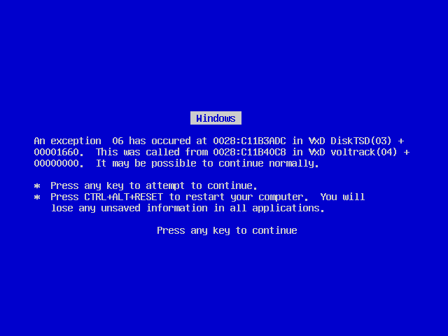

Slide 4


Background
Everybody makes mistakes from time to time and we all should get used to this fact.
In SE, mistakes can be dangerous due to the unpredictability of their consequences.
A program that contains many bugs, that seriously interfere with its functionality, is said to be buggy (defective).
What is a Software Bug
Why do Software have Bugs
What are the most common Software Bugs

Slide 5
Terms and Definitions
A Software Bug is a failure or flaw in a program that produces unexpected or incorrect results or behave in unintended ways*.
It’s an error that prevents the application from functioning as it should.
Bugs can trigger errors that may have ripple effects.
Bugs may have subtle effects or cause the program to crash or freeze the computer, i.e., some kind of failure.
Other bugs qualify as security bugs and might, for example, enable a malicious user to bypass access controls to obtain unauthorized privileges.
* ISTQB CFTL & https://link.springer.com/article/10.1007/s42979-024-02797-2

Slide 6


Failure (error affecting end-user)
Bug (fault)
Error (bug at runtime)

Slide 7
A Few Fun Facts
Some software bugs have been linked to serious disasters:
Bugs in code that controlled the Therac-25 radiation therapy machine were directly responsible for 1000’s of patient deaths in the 1980s.
In 1996, the European Space Agency's US$1 billion prototype Ariane 5 rocket had to be destroyed less than a minute after launch due to a bug in the on-board guidance computer program.
In 2002, a study commissioned by the US Department of Commerce's National Institute of Standards and Technology concluded that:
"software bugs, or errors, are so prevalent and so detrimental that they cost the US economy an estimated $59 billion annually, or about 0.6 percent of the gross domestic product".

Slide 8
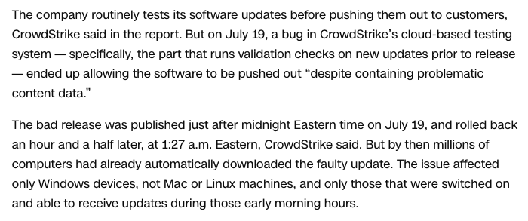


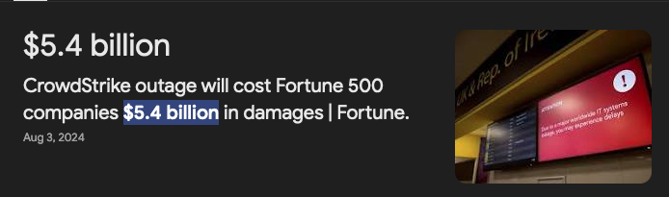

Slide 9
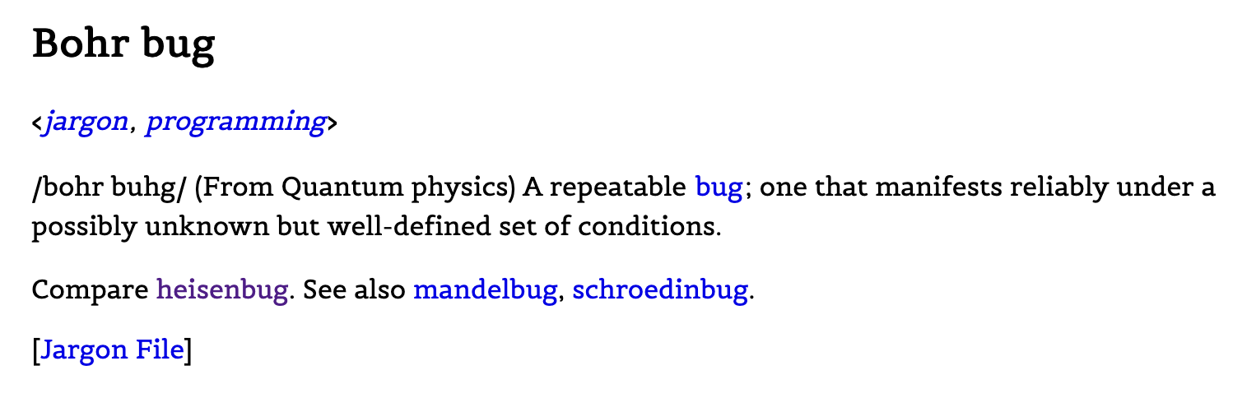
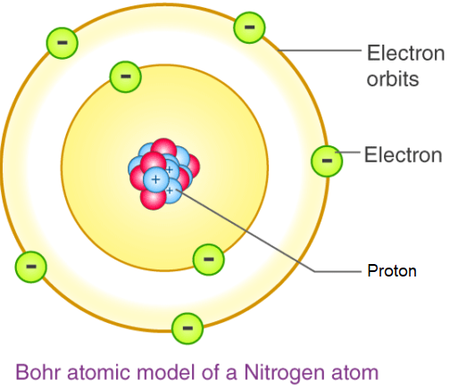
Type 1: Bohr

Slide 10

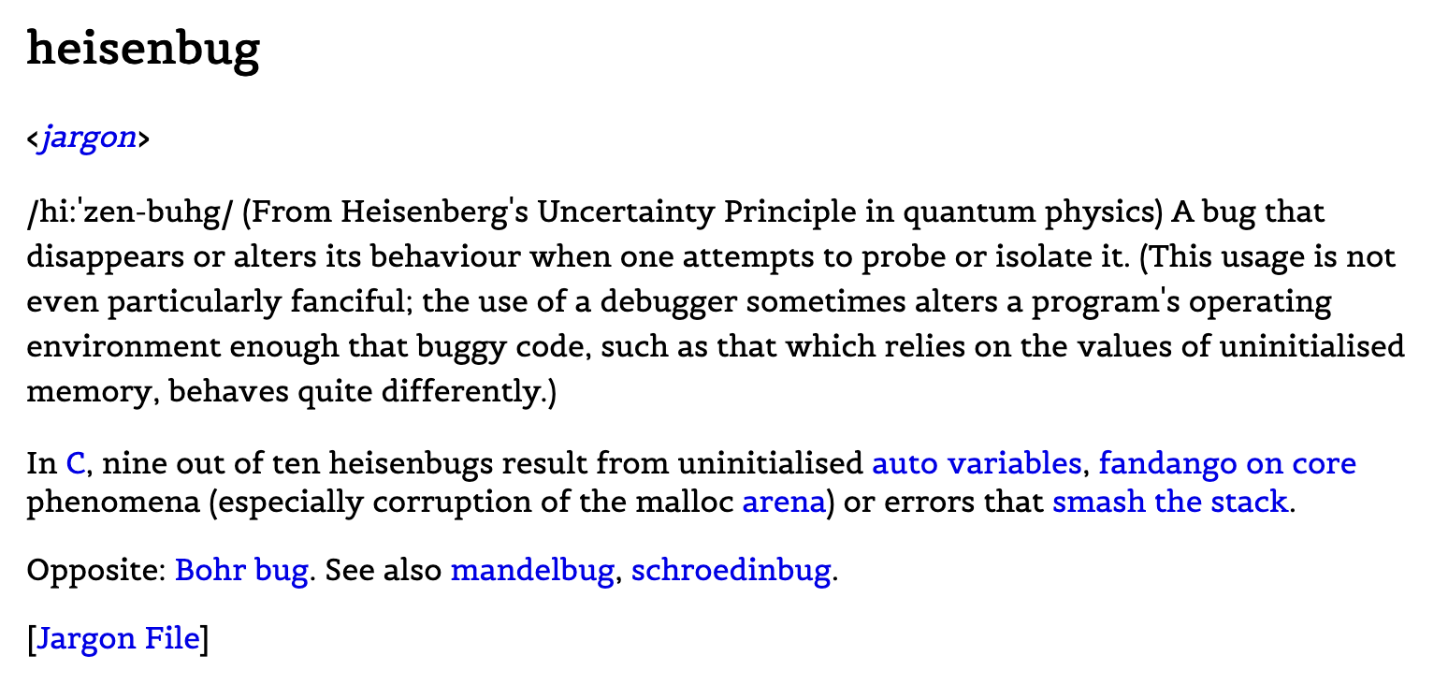
Type 2: Heisenberg

Slide 11
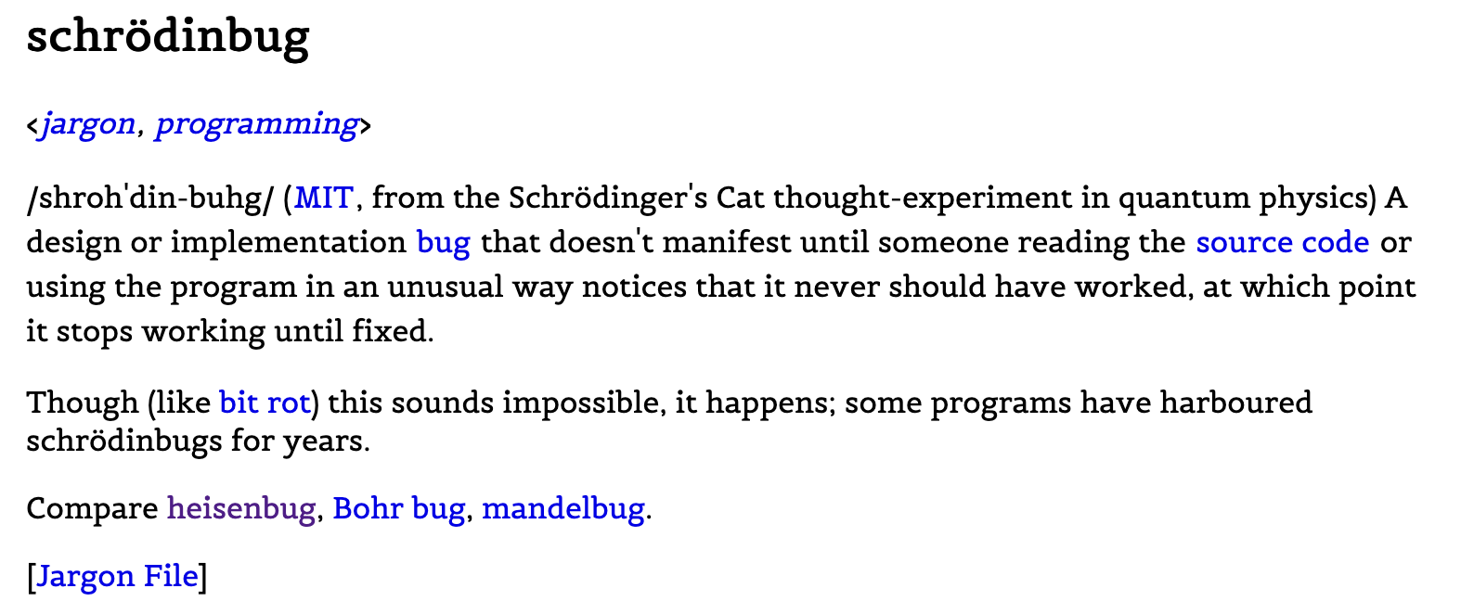
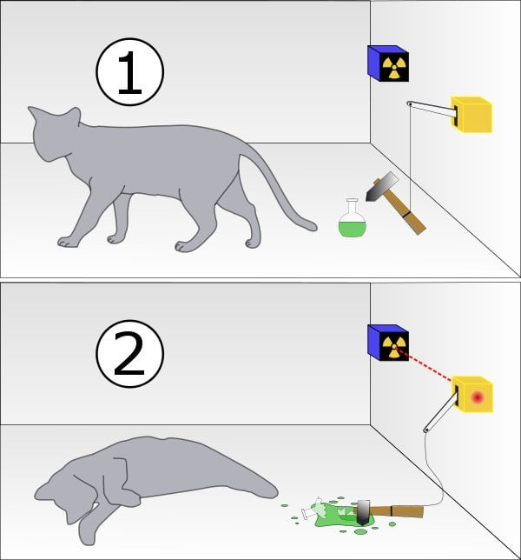
Type 3: Schrodinger

Slide 12

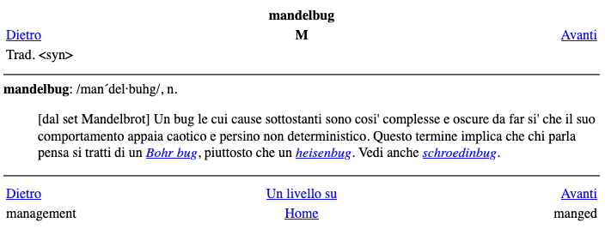

Type 4: Mandelbrot

Slide 13
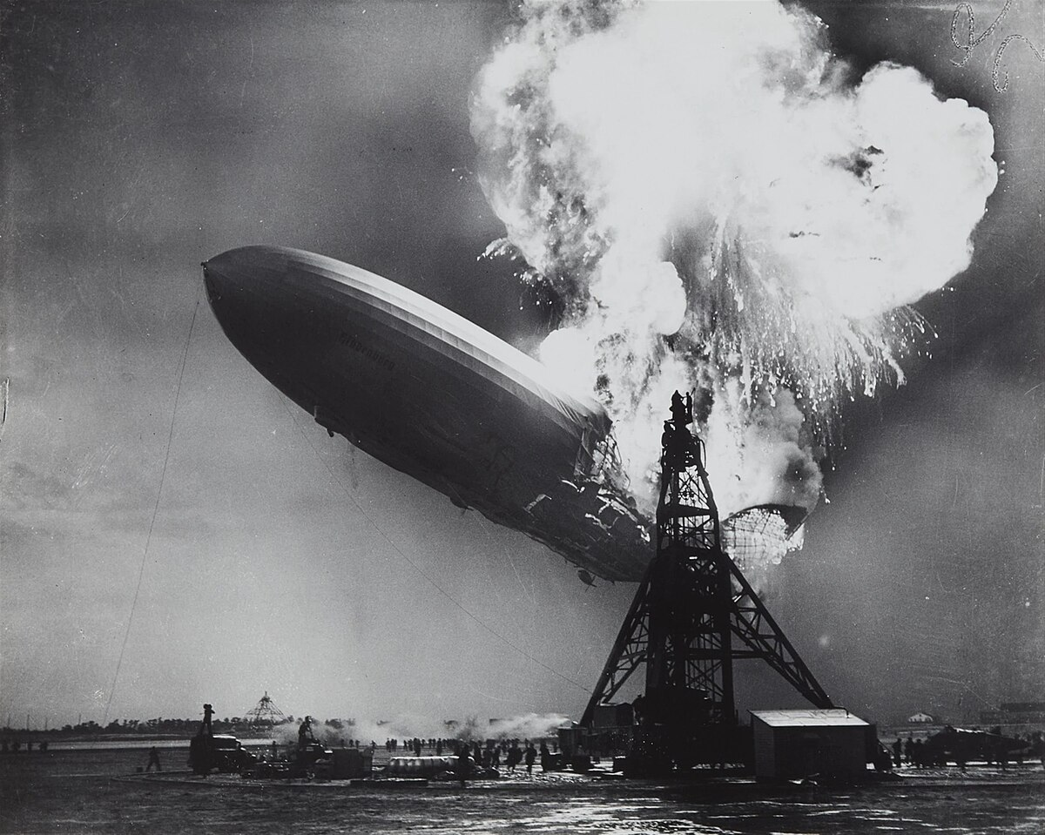
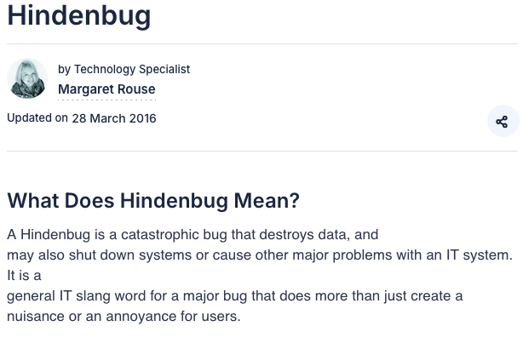
Type 5: Hindenburg
Notes:
In 1937, the German Hindenburg airship caught fire, ultimately killing dozens of people. The widely recorded disaster stood as a symbol of tragic emergency situations gone wrong. Nearly a century later, the name Hindenburg was morphed into this slang term to describe code problems that result in serious consequences for developers and users. A Hindenbug might result, for example, when a mislabeled variable or incorrect parameter causes input data to crash and be destroyed in a software application. It is a massive consequence, because that data cannot be recovered. Programmers take Hindenbugs very seriously.

Slide 14
Technical Reasons
Miscommunication
The success of any software application depends on communication between stakeholders, development and testing teams. Unclear requirements and misinterpretation of requirements are two major factors causing defects in software.
Software Complexity
The complexity of current software applications can be difficult for anyone without experience in modern-day software development (Windows-type interfaces, Client-Server, and Distributed Applications, Data Communications, enormous relational databases, …)
Programming Errors
Programmers can make programming mistakes (experience, domain knowledge, focus …). Lack of simple coding practices, unit testing, debugging are some of the common reasons why these issues get introduced at the development stage.

Slide 15
Technical Reasons
Changing Requirements
The customer may not understand the effects of changes or may understand and request them anyway.
Overconfidence
Saying “No problem ! It’s a piece of cake.” instead of “That adds a lot of complexity and we could end up making a lot of mistakes if we are not given the adequate time.”
Lack of Testing Skills
Domain knowledge and the tester’s ability to find defects can produce high-quality software. If neglected, they can result in defective software.

Slide 16
Technical Reasons
Crash
A situation when the software solution, operating system or program stops working properly and forces itself to shut down. It can cause a lot of damage because it often results in data loss.
Functional Error
One of the most basic qualities of software is the fact that everything works as it was intended to do and the software solution is fully functional. But if there is something wrong and the behavior of the software varies from the expected, we call it a functional error

Slide 17
Technical Reasons
Missing Command
This particular type of bug occurs when there is a command missing. The user is expecting an action or to be allowed to perform some activity.
Hardware Usage Errors
Occur when the software is being used on a wrong device or in an unadjusted environment. Most common hardware usage errors are caused by the wrong operating system, too low computing power or a mismatched device.
Control Flow Errors
Control flow of software describes what will be done next and on what conditions. Errors connected to the control flow prevent software from proceeding to the next tasks in the correct way.

Slide 18
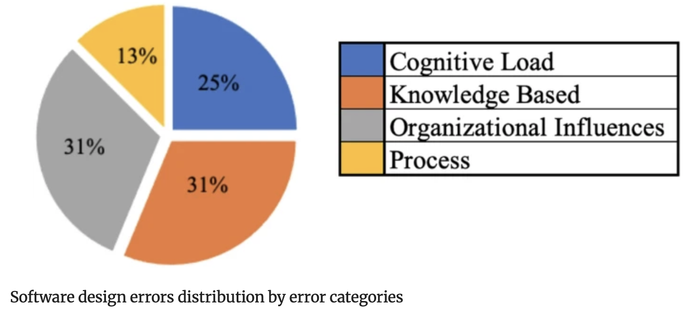
Other Reasons?

Slide 19
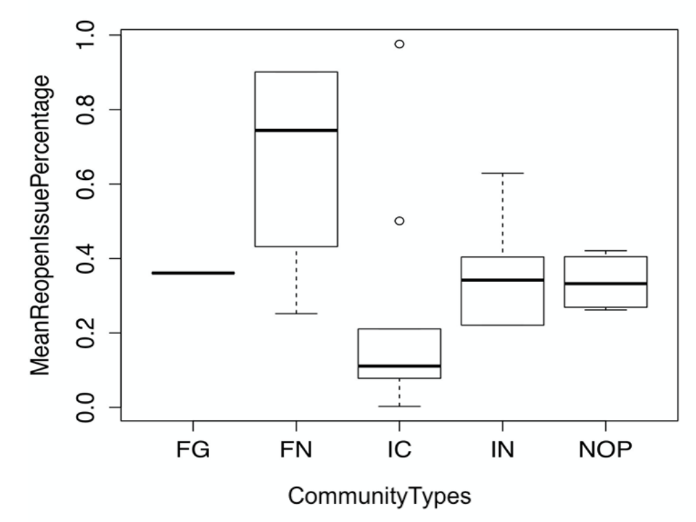
Wait… Organizational Reasons?*
* https://ceur-ws.org/Vol-2605/15.pdf

Slide 20
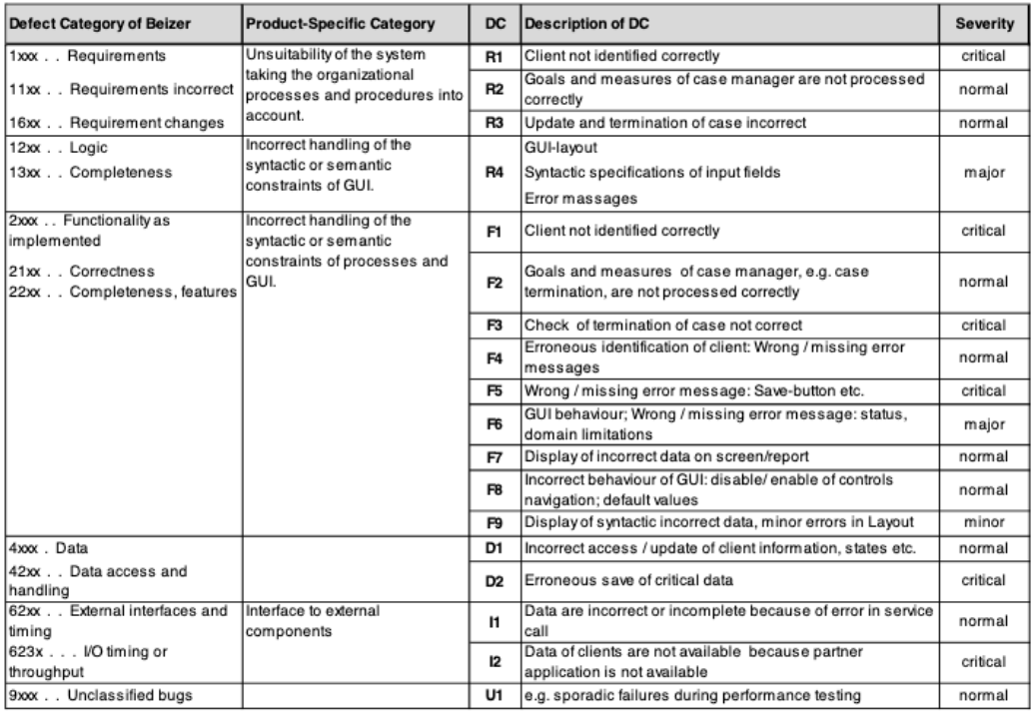

Slide 21
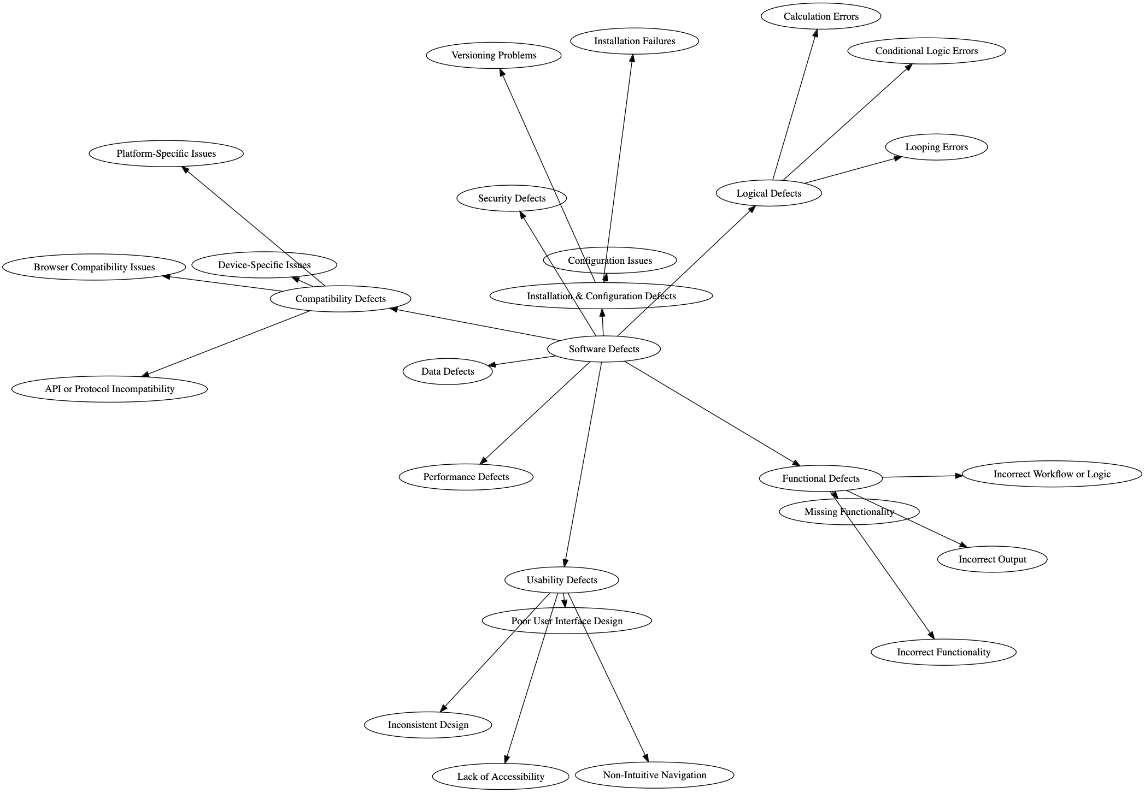

Slide 22
Config. 13%
Logical 26%
Functional 16%
Compatibility 22%
Usability 21%

Slide 23



The other side of the coin…
➔ Concurrency Bugs!

Slide 24
What Types Of Concurrency Bugs Exist?
Focus on four major open-source applications
MySQL, Apache, Mozilla, OpenOffice.
Application | What it does | Non-Deadlock | Deadlock
MySQL | Database Server | 14 | 9
Apache | Web Server | 13 | 4
Mozilla | Web Browser | 41 | 16
Open Office | Office Suite | 6 | 2
Total |  | 74 | 31
Bugs In Modern Applications

Slide 25
Non-Deadlock Bugs
Make up most concurrency bugs.
Two major types of non-deadlock bugs:
Atomicity violation
Order violation

Slide 26
Atomicity-Violation Bugs
The desired serializability among multiple memory accesses is violated.
Simple Example found in MySQL:
Two different threads access the field proc_info in the struct thd.
1 Thread1::
2 if(thd->proc_info){
3 …
4 fputs(thd->proc_info , …);
5 …
6 }
7
8 Thread2::
9 thd->proc_info = NULL;

Slide 27
Atomicity-Violation Bugs (Cont.)
Solution: Simply add locks around the shared-variable references.
pthread_mutex_t lock = PTHREAD_MUTEX_INITIALIZER;
Thread1::
pthread_mutex_lock(&lock);
if(thd->proc_info){
…
fputs(thd->proc_info , …);
…
}
pthread_mutex_unlock(&lock);
Thread2::
pthread_mutex_lock(&lock);
thd->proc_info = NULL;
pthread_mutex_unlock(&lock);

Slide 28
Order-Violation Bugs
The desired order between two memory accesses is flipped.
i.e., A should always be executed before B, but the order is not enforced during execution.
Example:
The code in Thread2 seems to assume that the variable mThread has already been initialized (and is not NULL).
Thread1::
void init(){
mThread = PR_CreateThread(mMain, …);
}
Thread2::
void mMain(…){
mState = mThread->State
}

Slide 29
Order-Violation Bugs (Cont.)
Solution: Enforce ordering using condition variables
pthread_mutex_t mtLock = PTHREAD_MUTEX_INITIALIZER;
pthread_cond_t mtCond = PTHREAD_COND_INITIALIZER;
int mtInit = 0;
Thread 1::
void init(){
…
mThread = PR_CreateThread(mMain,…);
// signal that the thread has been created.
pthread_mutex_lock(&mtLock);
mtInit = 1;
pthread_cond_signal(&mtCond);
pthread_mutex_unlock(&mtLock);
…
}
Thread2::
void mMain(…){
…

Slide 30
Order-Violation Bugs (Cont.)
// wait for the thread to be initialized …
pthread_mutex_lock(&mtLock);
while(mtInit == 0)
pthread_cond_wait(&mtCond, &mtLock);
pthread_mutex_unlock(&mtLock);
mState = mThread->State;
…
}

Slide 31

And now… the fresh prince of concurrency bugs...
<momentOfSuspense>

Slide 32
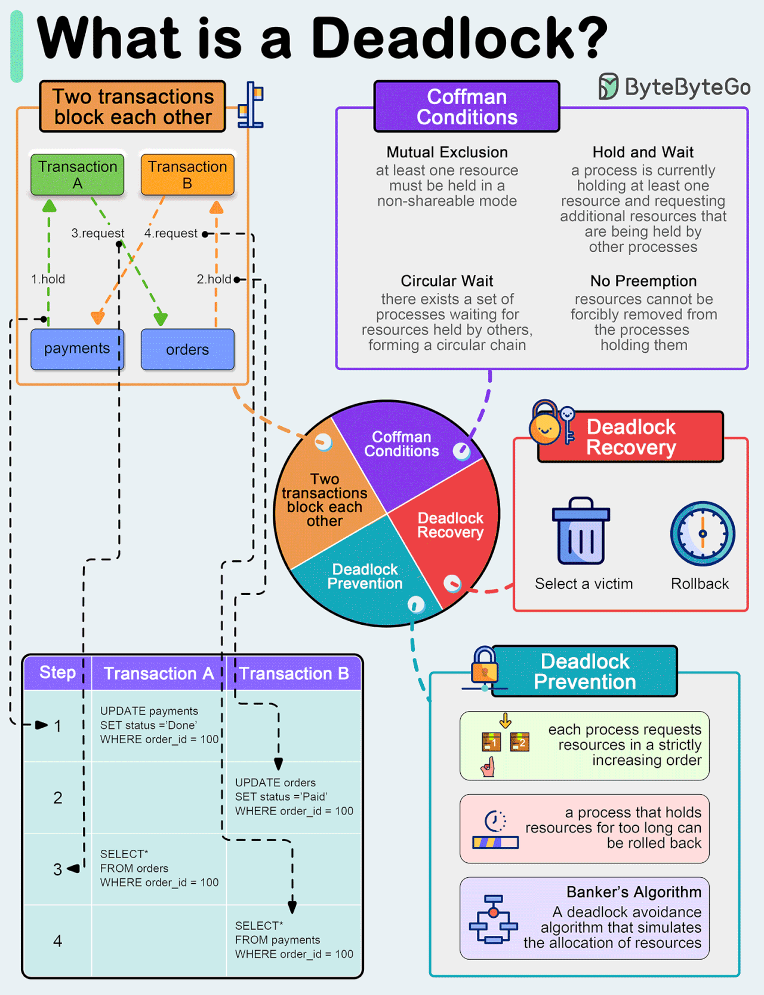

Slide 33
Deadlock Bugs
Thread 1: lock(L1); lock(L2); | Thread 2: lock(L2); lock(L1);
The presence of a cycle
Thread1 is holding a lock L1 and waiting for another one, L2.
Thread2 that holds lock L2 is waiting for L1 to be released.
Thread 1
Holds
Lock L1
Wanted by
Wanted by
Lock L2
Thread 2
Holds

Slide 34
Why Do Deadlocks Occur?
Reason 1:
In large code bases, complex dependencies arise between components.
Reason 2:
Due to the nature of encapsulation
Hide details of implementations and make software easier to build in a modular way.
Such modularity does not mesh well with locking.

Slide 35
Why Do Deadlocks Occur? (Cont.)
Example: Java Vector class and the method AddAll()
Locks for both the vector being added to (v1) and the parameter (v2) need to be acquired explicitly.
The routine maybe acquires said locks in some arbitrary order (v1 then v2).
If some other thread calls v2.AddAll(v1) at nearly the same time → We have the potential for deadlock.
Vector v1,v2;
v1.AddAll(v2);

Slide 36
Conditions for Deadlock
Four conditions need to hold for a deadlock to occur.
If any of these four conditions are not met, deadlock cannot occur.
Condition | Description
Mutual Exclusion | Threads claim exclusive control of resources that they require.
Hold-and-wait | Threads hold resources allocated to them while waiting for additional resources
No preemption | Resources cannot be forcibly removed from threads that are holding them.
Circular wait | There exists a circular chain of threads such that each thread holds one more resources that are being requested by the next thread in the chain

Slide 37
Prevention – Circular Wait
Provide a total ordering on lock acquisition
This approach requires careful design of global locking strategies.
Example:
There are two locks in the system (L1 and L2)
We can prevent deadlock by always acquiring L1 before L2.

Slide 38
Prevention – Hold-and-wait
Acquire all locks at once, atomically.
This code guarantees that no untimely thread switch can occur amid lock acquisition.
Problem:
Require us to know when calling a routine exactly which locks must be held and to acquire them ahead of time.
Decrease concurrency
1 lock(prevention);
2 lock(L1);
3 lock(L2);
4 …
5 unlock(prevention);

Slide 39
Prevention – No Preemption
Multiple lock acquisition often gets us into trouble because when waiting for one lock we are holding another.
trylock()
Used to build a deadlock-free, ordering-robust lock acquisition protocol.
Grab the lock (if it is available).
Or, return -1: you should try again later.
top:
lock(L1);
if( tryLock(L2) == -1 ){
unlock(L1);
goto top;
}

Slide 40
Prevention – No Preemption (Cont.)
livelock
Both systems are running through the code sequence over and over again.
Progress is not being made.
Solution:
Add a random delay before looping back and trying the entire thing over again.

Slide 41
Prevention – Mutual Exclusion
wait-free
Using powerful hardware instruction.
You can build data structures in a manner that does not require explicit locking.
int CompareAndSwap(int *address, int expected, int new){
if(*address == expected){
*address = new;
return 1; // success
}
return 0;
}

Slide 42
Prevention – Mutual Exclusion (Cont.)
We now want to atomically increment a value by a certain amount:
Repeatedly tries to update the value to the new amount and uses CompareAndSwap to do so.
No lock is acquired
No deadlock can arise
livelock is still a possibility.
void AtomicIncrement(int *value, int amount){
do{
int old = *value;
}while( CompareAndSwap(value, old, old+amount)==0);
}

Slide 43
Prevention – Mutual Exclusion (Cont.)
More complex example: list insertion
If called by multiple threads at the “same time”, this code has a race condition.
void insert(int value){
node_t * n = malloc(sizeof(node_t));
assert( n != NULL );
n->value = value ;
n->next = head;
head = n;
}

Slide 44
Prevention – Mutual Exclusion (Cont.)
Solution:
Surrounding this code with a lock acquire and release.
wait-free manner using CompareAndSwap instructions
void insert(int value){
node_t * n = malloc(sizeof(node_t));
assert( n != NULL );
n->value = value ;
lock(listlock); // begin critical section
n->next = head;
head = n;
unlock(listlock) ; //end critical section
}
void insert(int value) {
node_t *n = malloc(sizeof(node_t));
assert(n != NULL);
n->value = value;
do {
n->next = head;
} while (CompareAndSwap(&head, n->next, n));
}

Slide 45
Deadlock Avoidance via Scheduling
In some scenarios deadlock avoidance is preferable.
Global knowledge is required:
Which locks various threads might grab during their execution.
Subsequently schedules said threads in a way as to guarantee no deadlock can occur.

Slide 46
Example of Deadlock Avoidance via Scheduling (1)
We have two processors and four threads.
Lock acquisition demands of the threads:
A smart scheduler could compute over that, as long as T1 and T2 are not run at the same time, no deadlock could ever arise.
 | T1 | T2 | T3 | T4
L1 | yes | yes | no | no
L2 | yes | yes | yes | no
CPU 1
T3
T4
CPU 2
T1
T2

Slide 47
Example of Deadlock Avoidance via Scheduling (2)
More contention for the same resources
A possible schedule that guarantees that no deadlock could ever occur.
The total time to complete the jobs is lengthened considerably.
 | T1 | T2 | T3 | T4
L1 | yes | yes | yes | no
L2 | yes | yes | yes | no
CPU 1
T4
CPU 2
T1
T2
T3

Slide 48
Detect and Recover
Allow deadlock to occasionally occur and then take some action.
Example: if OS freezes, kill and recover.
Many database systems employ deadlock detection and recovery technique.
A deadlock detector runs periodically.
Building a resource graph and checking it for cycles.
In deadlock, the system need to be restarted.

Slide 49
Real-life assessment from SOTA
105 real-world concurrency bugs from 4 large open
source programs*
Study from 4 dimensions
Bug patterns
Manifestation condition
Diagnosing strategy
Fixing methods
ASPLOS’08 Paper by Yuanyuan Zhou et al.

Slide 50
Methodology: Evaluated Applications
MySQL
Apache
Mozilla
OpenOffice
Software Type
Server
Server
Client
GUI
Language
C++/C
Mainly C
C++
C++
LOC (M lines)
2
0.3
4
6
Bug DB history
6 years
7 years
10 years
8 years

Slide 51
Methodology: Bug Sources
MySQL
Apache
Mozilla
OpenOffice
Total
Non-deadlock
14
13
41
6
74
Deadlock
9
4
16
2
31
Limitations
No scientific computing applications
No JAVA programs
Never-enough bug samples

Slide 52
Non-Deadlock Bug Pattern
Pattern
Classified based on root causes
Categories
Atomicity violation
The desired atomicity of certain
code region is violated
Order violation
The desired order between
two (sets of) accesses is flipped
Others
Thread 1
Thread 2
X
Thread 1
Thread 2
X

Slide 53
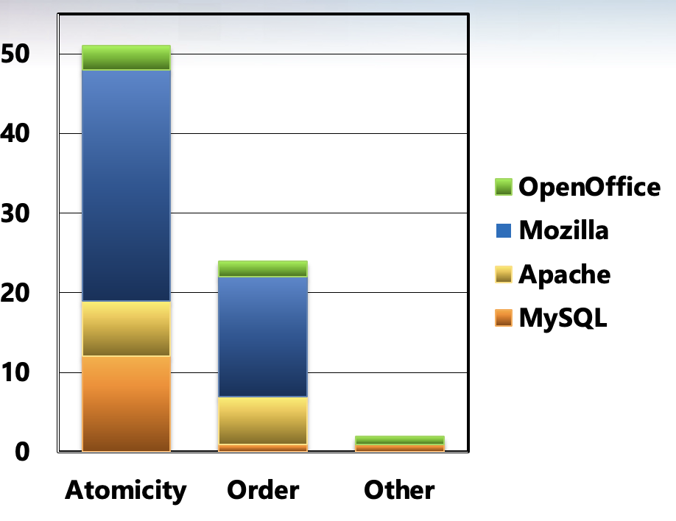
Non-Deadlock Bug Pattern Characteristics
Implications
We should focus on atomicity violation and order violation
Bug detection tools for order violation bugs are desired
*There are 3-bug overlap between Atomicity and Order

Slide 54
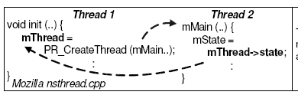
An Order-Related Bug Example
Note that order violations can be fixed by adding locks to ensure atomicity with the
previous operation to ensure order. But the root cause is the incorrect assumption about execution order.

Slide 55
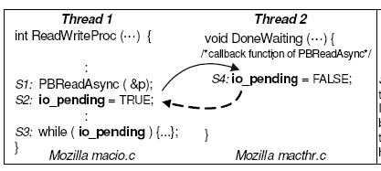
Another Example
OK
Woops!

Slide 56
How to Trigger a Bug?
Manifestation
Bug manifestation condition
A specific execution order among a smallest set of memory accesses
The bug is guaranteed to manifest, as long as the condition is satisfied
How many threads are involved?
How many variables are involved?
How many accesses are involved?

Slide 57
Single Variable vs. Multiple Variable
Findings
49 (66%)
# of Bugs
25 (34%)
Implications
Single variables are more common
→ The widely-used simplification is reasonable
Multi-variable concurrency bugs are non-negligible
→ Techniques to detect multi-variable concurrency bugs are needed

Slide 58
Multi-Variable Concurrency Bug Example
Thread 1
Thread 2
js_FlushPropertyCache ( … ) {
memset ( cache→table, 0, SIZE);
…
cache→empty = TRUE;
}
js_PropertyCacheFill ( … ) {
cache→table[indx] = obj;
…
cache→empty = FALSE;
}
Controlling the order among accesses to any one individual variable
cannot guarantee bug manifestation

Slide 59
Number of Accesses/Operations Involved
Non-deadlock bugs
Deadlock bugs
Double lock
# of Bugs
7 (9%)
1 (3%)
Concurrent program testing can focus on small groups of accesses
The testing target shrinks from exponential to polynomial

Slide 60
Number Threads Involved
101 out of 105 (96%) bugs involve at most two threads
Most bugs can be reliably disclosed if we check all possible interleaving between each pair of threads
Few bugs cannot
Example: Intensive resource competition among many threads causes unexpected delay

Slide 61
How Were Non-Deadlock Bugs Fixed?
Fix
Adding/changing locks 20 (27%)
Condition check 19 (26%)
Data-structure change 19 (26%)
Code switch 10 (13%)
Other 6 ( 8%)
No silver bullet for fixing concurrency bugs.
Lock usage information is not enough to fix bugs.
Implications

Slide 62
How Were Deadlock Bugs Fixed?
Fix
Give up resource acquisition 19 (61%)
Change resource acquisition order 7 (23%)
Split the resource to smaller ones 1 ( 3%)
Others 4 (13%)
Might introduce
non-deadlock bugs
Implications
We need to pay attention to the
correctness of ``fixed’’ deadlock bugs

Slide 63
Other Findings from SOTA
Impact of concurrency bugs
~ 70% leads to program crash or hang
Reproducing bugs are critical to diagnosis
Many examples
Programmers lack diagnosis tools
No automated diagnosis tools mentioned
Most are diagnosed via code review
Reproduce bugs are extremely hard and directly determines the diagnosing time
60% 1st-time patches still contain concurrency bugs (old or new)
Usefulness and concerns of transactional memory

Slide 64
Summary
Bug detection needs to look at order-violation bugs and multi-variable concurrency bugs
Testing can target at more realistic interleaving coverage goals
Fixing concurrency bugs is not trivial and not easy to get right
Support from automated tools is needed
Diagnosing tools are needed, especially bug reproducing tools
Current bug detection tools are not widely used

Slide 65
Other Related Works
AVIO: atomicity violation detection [ASPLOS’06]
Automatically extracting interleaving invariants to detect violations
Multi-variable concurrency bug detection [SOSP’07]
Mining variable correlations and then feed them to bug detectors
Concurrency interleaving testing coverage criteria [FSE’07]

Slide 66
What can we do?

Slide 67


Slide 68
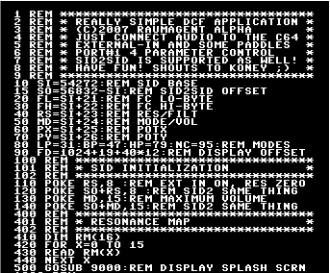
Approaches for Defect Prediction
1. Product-centric
2. Process-centric
3. Combination of both
measures extracted from the:
static/dynamic structure of source code
design documents
design requirements
Change history of source files
(number or size of modifications, age of a file)
Changes in the team structure
Testing effort
Technology
Other human factors to software defects

Slide 69
Previous Work
Two aspects of defect prediction:
The relationship between software defects and code metrics
Impact of the
software process
on the
defectiveness of software
No agreed answer
No cost-insensitive prediction

Slide 70
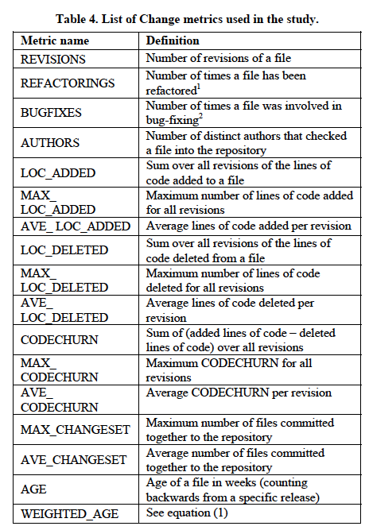
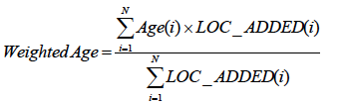
One Possible Proposal of Change Metrics
renaming or moving software elements
the number of files that have been committed together with file x
in weeks, starting from release date to its first appearance
Notes:
built-in refactorings perform most of the tedious and error-prone tasks such as

Slide 71
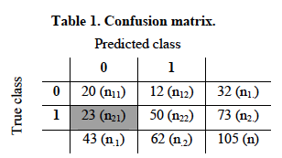
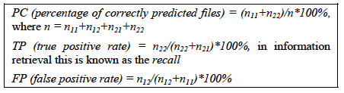
Results Assessing Classification Accuracy

Slide 72
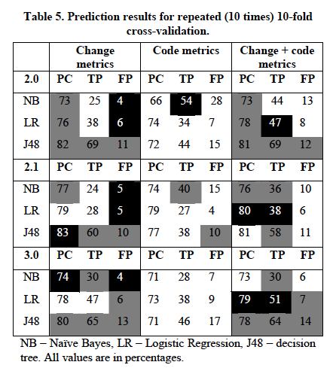
Accuracy Classification Results
By analyzing the decision trees:
Defect Free:
Large MAX_CHANGESET or
Low REVISIONS
Smaller MAX_CHANGESET and
Low REVISIONS and
REFACTORINGS
Defect Prone:
High number of BUGFIXES

Slide 73
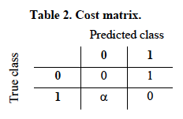
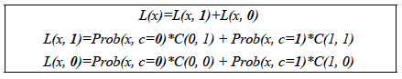
Cost-Sensitive Classification
Cost-sensitive classification - costs associated with different errors made by a model
α>1 FN implicate higher costs than FP
Costly to fix an undetected defect in post release cycle than to inspect defect-free file
min

Slide 74
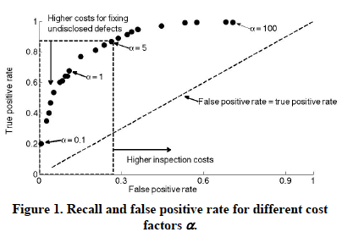
Cost-Sensitive Defect Prediction Results for J48 Learner, Release 2.0
Use some heuristics to stop increasing the recall
FP<30%
α=5

Slide 75
Limitations
Dependability on a specific environment
Conclusions are on only three data miners
Choice for code and change metrics
Reliability of the data
mapping between defects and locations in source code
extraction of code or change metrics from repositories

Slide 76
Conclusions of study (just a sample*)
18 change metrics, J48 learner, α=5 give accurate results for 3 releases of the Eclipse project:
>75% of correctly classified files
>80% recall
< 30% FP rate
Hence, the change metrics contain more discriminatory and meaningful information about the defect distribution that the source code itself.
Important change metrics:
Defect prone
files with high revision numbers
large bug fixing activities
Defect-free
files that are large CVS commits
refactored several times files
*more on this further on in the course!

Slide 77

The most common reason for Software Bugs is human mistakes in software design and coding.
It will be easier to take corrective actions to minimize software defects once the causes are known.
There are certain errors that occur frequently in many software projects. An experienced tester should spot them.
A lot of IT companies have their own testers who work long hours with every element of a new software solution to find errors and to eliminate them one by one.

Slide 78

Questions?

